Slide 1

18CSE392T – Machine Learning I
Department of Data Science and Business Systems

Slide 2
Reinforcement Learning

Slide 3
Definition
Reinforcement learning (RL) is a type of ML which is all about taking suitable action to maximize reward in a particular situation.
It is employed by various software and machines to find the best possible behavior or path it should take in a specific situation.
RL means to establish or encourage a pattern of behavior.

Slide 4
Reinforcement Learning is a subfield of machine learning that teaches an agent how to choose an action from its action space, within a particular environment, in order to maximize rewards over time.

Slide 5
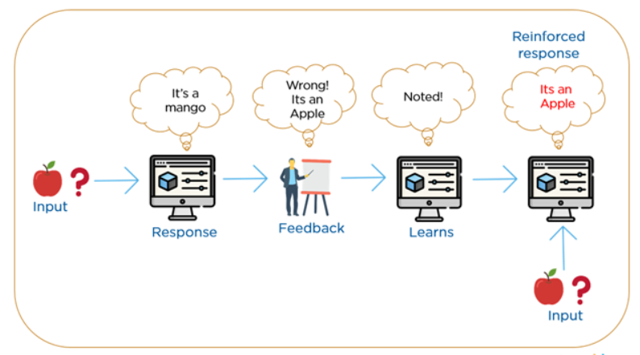

Slide 6
Essential Elements
Agent. The program you train, with the aim of doing a job you specify.
Environment. The world, real or virtual, in which the agent performs actions.
Action. A move made by the agent, which causes a status change in the environment.
Rewards. The evaluation of an action, which can be positive or negative.

Slide 7
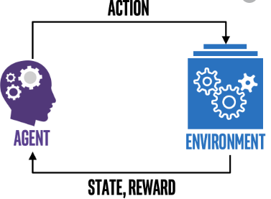

Slide 8
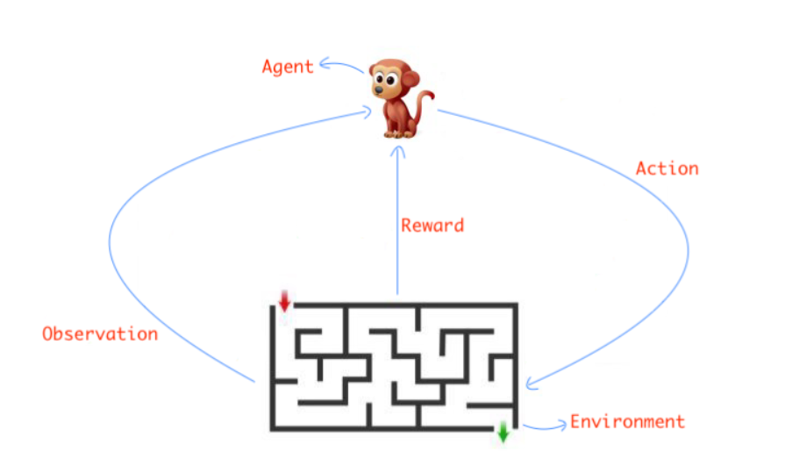

Slide 9
RL Works
Observation of the environment
Deciding how to act using some strategy
Acting accordingly
Receiving a reward or penalty
Learning from the experiences and refining our strategy
Iterate until an optimal strategy is found

Slide 10
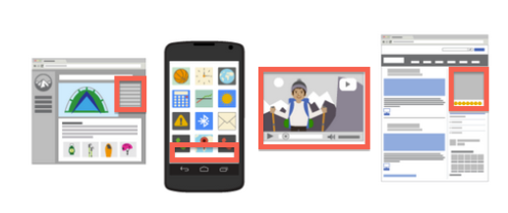
Placement of Ads
Agent: The program making decisions on how many ads are appropriate for a page.
Environment: The web page.
Action: One of three: 1. Putting another ad on the page. 2. Dropping an ad from the page. 3. Neither adding nor removing.
Reward: Positive when revenue increases; negative when revenue drops.

Slide 11
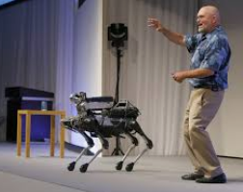
Controlling A Walking Robot
Agent: The program controlling a walking robot.
Environment: The real world.
Action: One out of four moves
1. Forward 2. Backward 3. Left and 4. Right.
Reward: Positive when it approaches the target destination; negative when it wastes time, goes in the wrong direction or falls down.
In this final example, a robot can teach itself to move more effectively by adapting its policy based on the rewards it receives.

Slide 12


